Slide 1

I’ve been doing some syncing…
Paul Lammertsma
CTO, Pixplicity

Slide 2
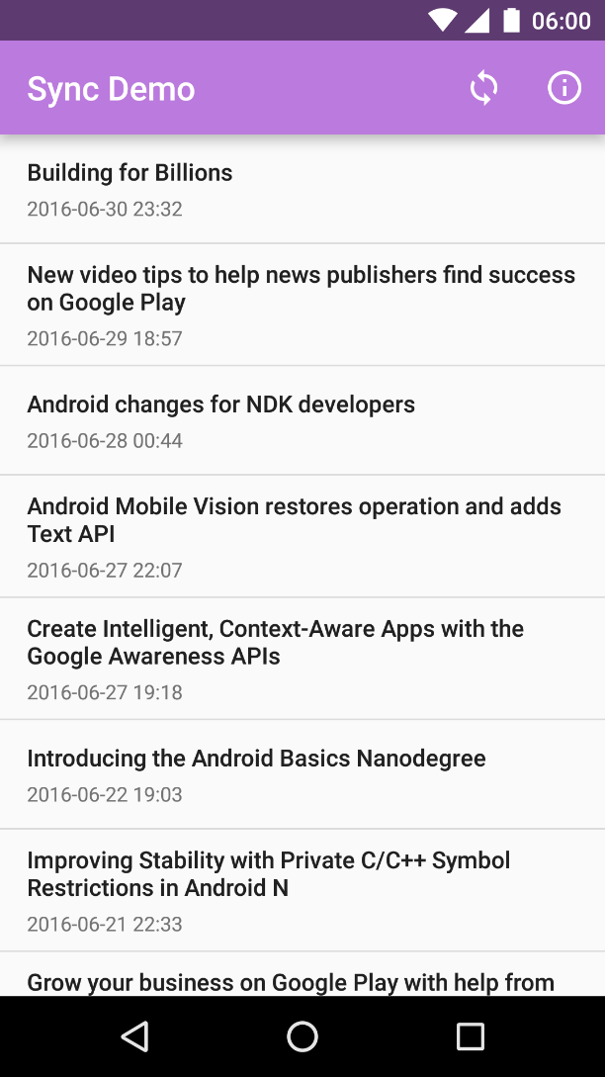
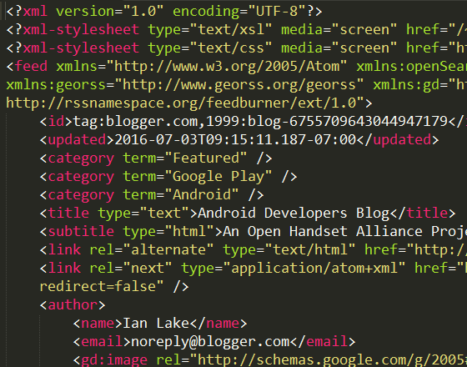
UI
Network
ze internet

Slide 3
Bad idea #1a:
No caching
UI
Network
ze internet

Slide 4
Bad idea #1a:
No caching
UI
Bad idea #1b:
No separation of concerns
ActivityA
FragmentX
FragmentY
Network
ze internet

Slide 5
UI
Network
ze internet

Slide 6
UI
ContentResolver.query()
ContentProvider
ContentResolver.insert()
Network
ze internet

Slide 7
CursorLoader
UI
ContentObserver
ContentResolver.query()
ContentProvider
onCreate(): fetch data
ContentResolver.insert()
Network
Bad idea #2a:
Stale data
Bad idea #2b:
Assumes internet connection
ze internet

Slide 8
CursorLoader
UI
ContentObserver
ContentResolver.query()
ContentProvider
Bad idea #3:
Bandwidth/CPU starvation
ContentResolver.insert()
Service
Network
CONNECTIVITY_CHANGE
ze internet
BroadcastReceiver

Slide 9
CursorLoader
UI
ContentObserver
ContentResolver.query()
ContentProvider
ContentResolver.insert()
SyncAdapter
Network
Android Framework
ze internet
Hey, this would be a great moment to synchronize!

Slide 10
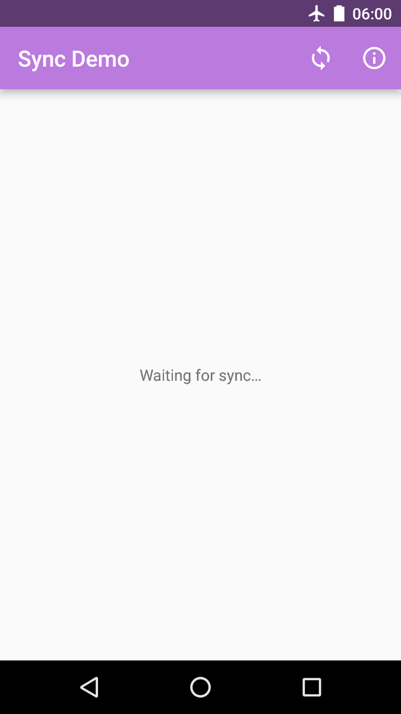


Sync Demo

Slide 11
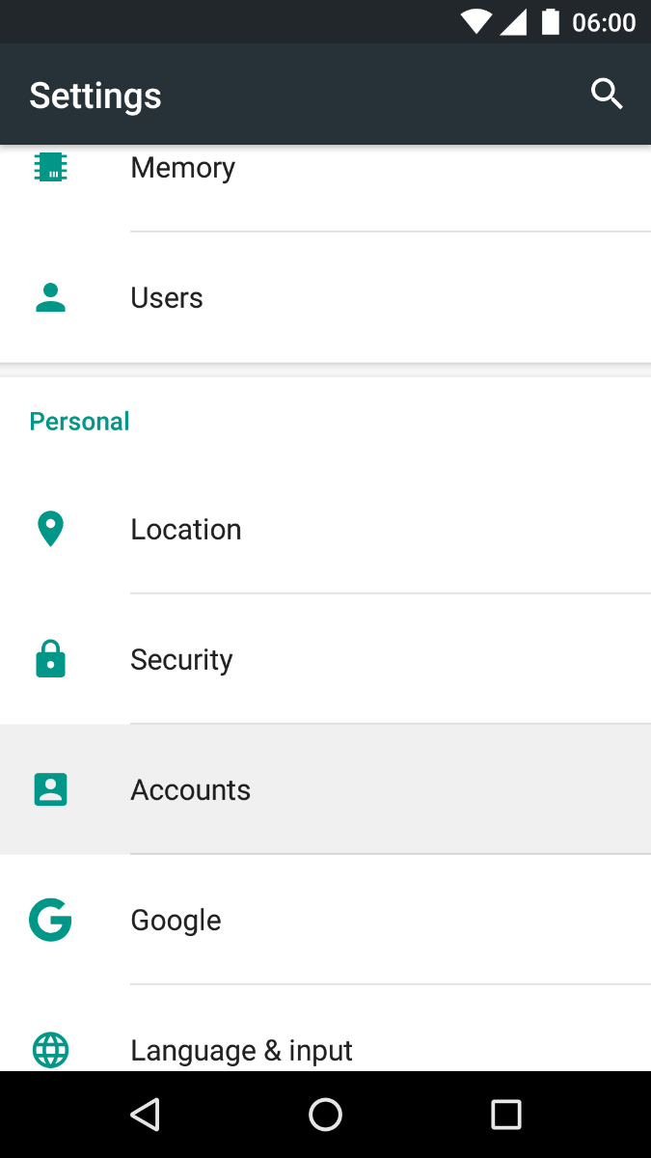
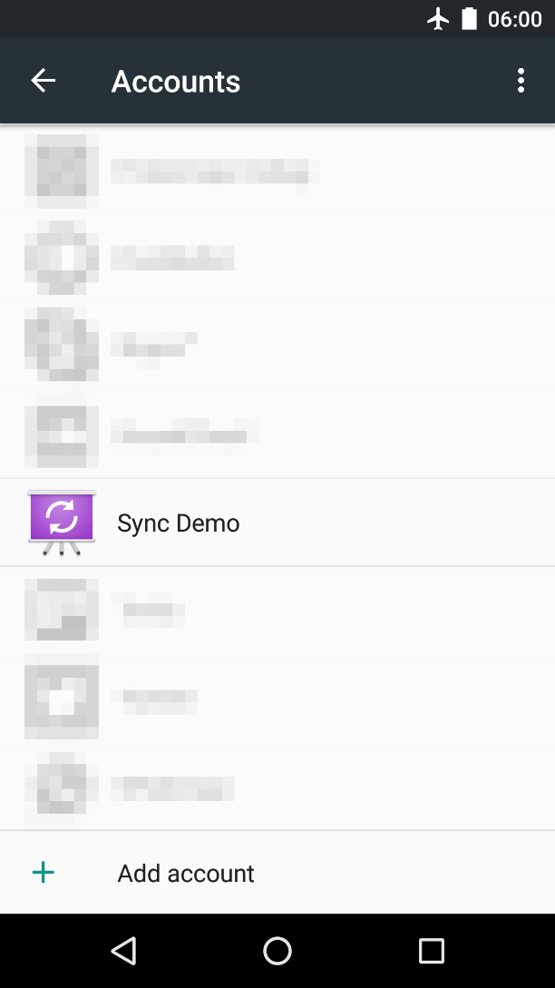
Android Settings

Slide 12
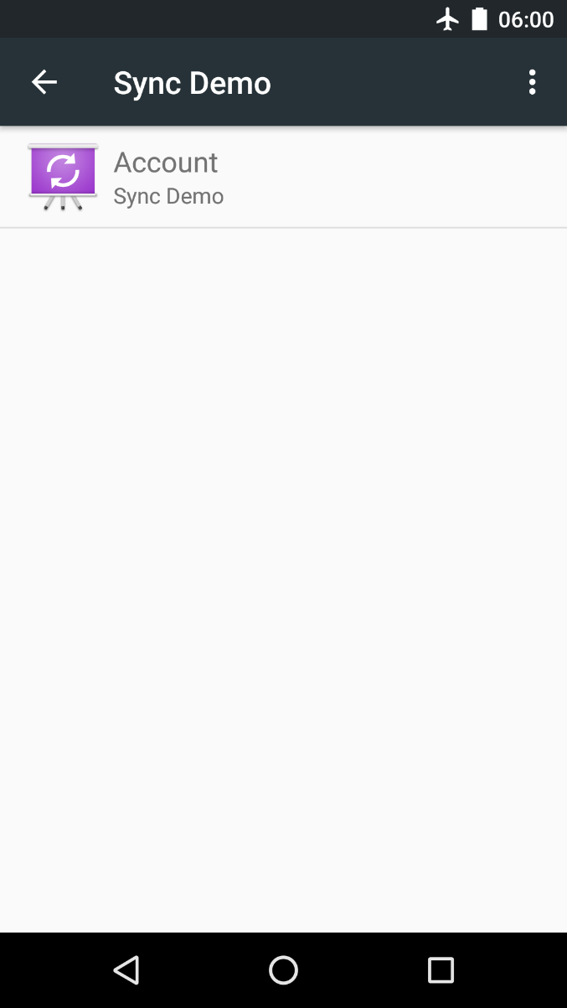
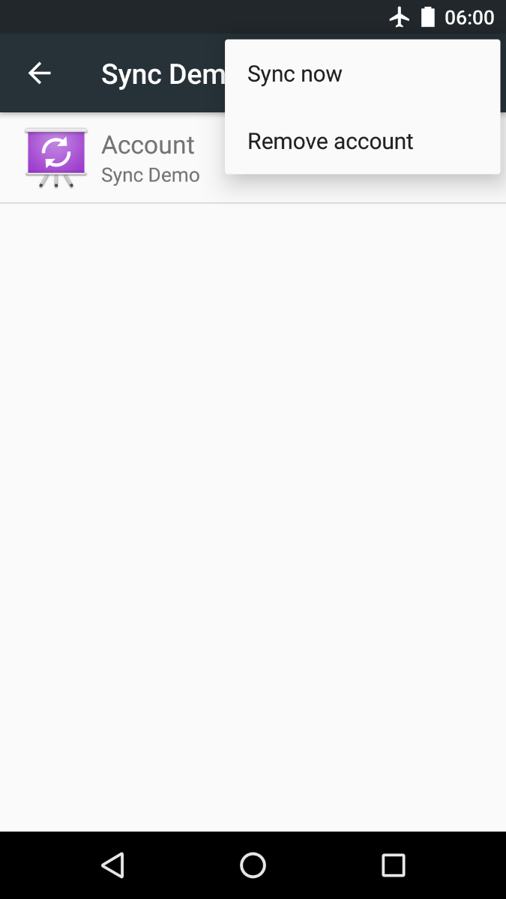
Android Settings

Slide 13
CursorLoader
UI
ContentObserver
ContentResolver.query()
ContentProvider
ContentResolver.insert()
SyncAdapter
Network
Android Framework
ze internet
Hey, this would be a great moment to synchronize!

Slide 14
CursorLoader
UI
ContentObserver
ContentResolver.query()
ContentProvider
ContentResolver.insert()
Service
SyncAdapter
Network
Binds to service
Android Framework
ze internet

Slide 15
Service
SyncAdapter

Slide 16
https://github.com/googlesamples/android-BasicSyncAdapter
https://developer.android.com/training/sync-adapters/creating-sync-adapter.html
https://developer.android.com/training/sync-adapters/index.html
http://blog.udinic.com/2013/07/24/write-your-own-android-sync-adapter/
https://software.intel.com/en-us/android/articles/handling-offline-capability-and-data-sync-in-an-android-app-part-2

Slide 17
SyncAdapters can be used to:
fetch background data for an app.
execute your data transfer code at configurable intervals, while efficiently using battery and other system resources
Elements of a sync adapter:
Creates a sync adapter class.
Creates a bound Service which the OS uses to initiate a sync.
Defines the sync adapter properties in an XML resource file.
Declares the bound Service in the app manifest.

Slide 18
Extend the base sync adapter class AbstractThreadedSyncAdapter
/** * Handle the transfer of data between a server and an * app, using the Android sync adapter framework. */ public class SyncAdapter extends AbstractThreadedSyncAdapter {
/** * Set up the sync adapter */ public SyncAdapter(Context context, boolean autoInitialize) {
super(context, autoInitialize);
}
public SyncAdapter( Context context, boolean autoInitialize, boolean allowParallelSyncs) { super(context, autoInitialize, allowParallelSyncs);
}
}

Slide 19
onPerformSync()
Sync adapter framework invokes your SyncAdapter
Calls onPerformSync()
Account
Bundle
Authority
ContentProviderClient
SyncResult

Slide 20
onPerformSync()
/* * Specify the code you want to run in the sync adapter. The entire * sync adapter runs in a background thread, so you don't have to set * up your own background processing. */ @Override public void onPerformSync( Account account, Bundle extras, String authority, ContentProviderClient provider, SyncResult syncResult) { /* * Put the data transfer code here. */ ... }

Slide 21
Beginner’s Workshop
Paul Lammertsma
CTO, Pixplicity

